Slide 1
High Pass Filter VS Low Pass Filter
S_rate = 45000
T = 1/S_rate
t = 0.2
N = S_rate * t
freq = 100
omega = 2*np.pi*freq
t_seq = np.arange(N)*T
b = 0.5 * np.sin(omega*t_seq)
plt.plot(b)
plt.show

Slide 2
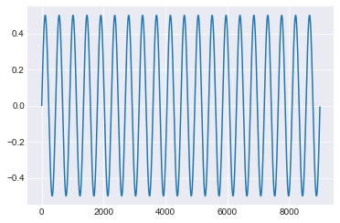
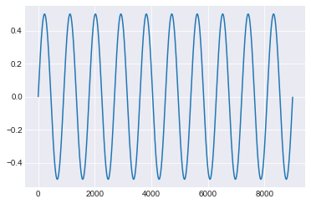
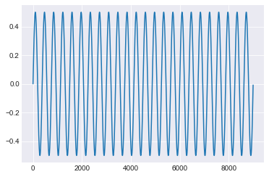
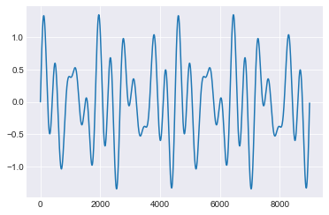
High Pass Filter VS Low Pass Filter
Frequency A = 100 KHz
Frequency B = 50 KHz
Frequency C =120

Slide 3
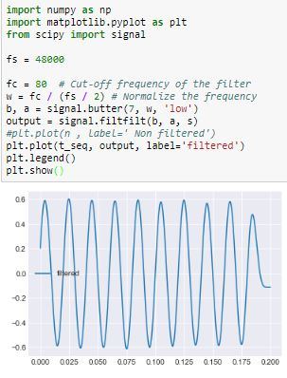
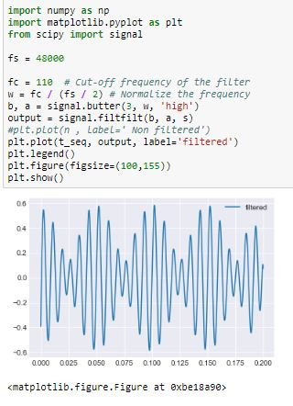
High Pass Filter VS Low Pass Filter

Slide 4
شاهية طيبة

